Slide 1
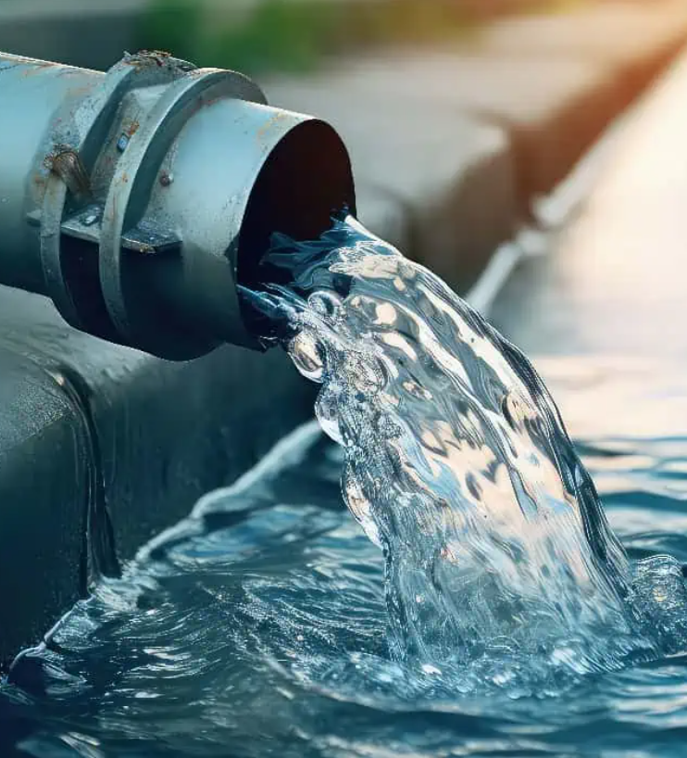
11/25/25
Viscosity of Non-Newtonian Fluid
Angelica Ramirez, Hiba Naqvi, Jazmin Aca, Srija Bomma

Slide 2
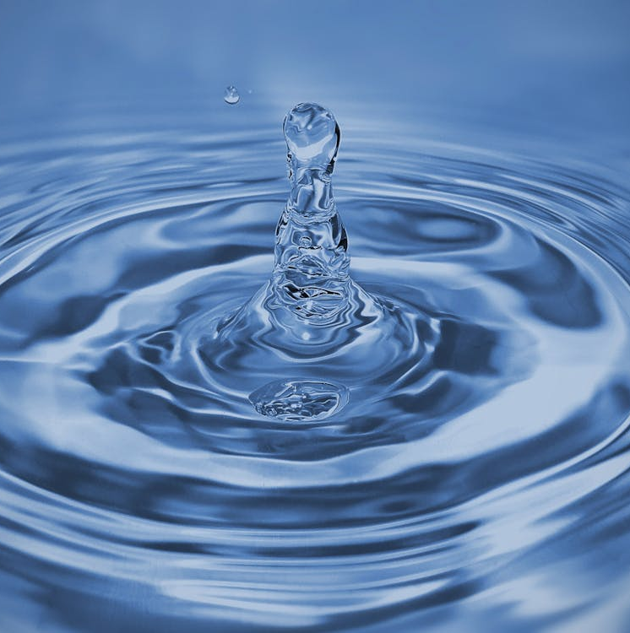
Table of Contents
Introduction
Theory
Apparatus
Materials and Supplies
Procedure
Dangers
Challenges

Slide 3
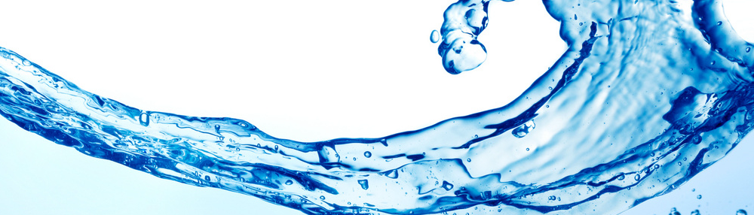
Introduction
The objective of this experiment is to investigate the flow behavior of a non-Newtonian fluid (1 wt% Carbopol solution) using capillary tubes of varying radii and length. The pressure and volumetric flow rate are measured, which are used to calculate the viscosity, shear stress, velocity gradient, flow behavior index, and consistency coefficient and compare with empirical correlations.

Slide 4
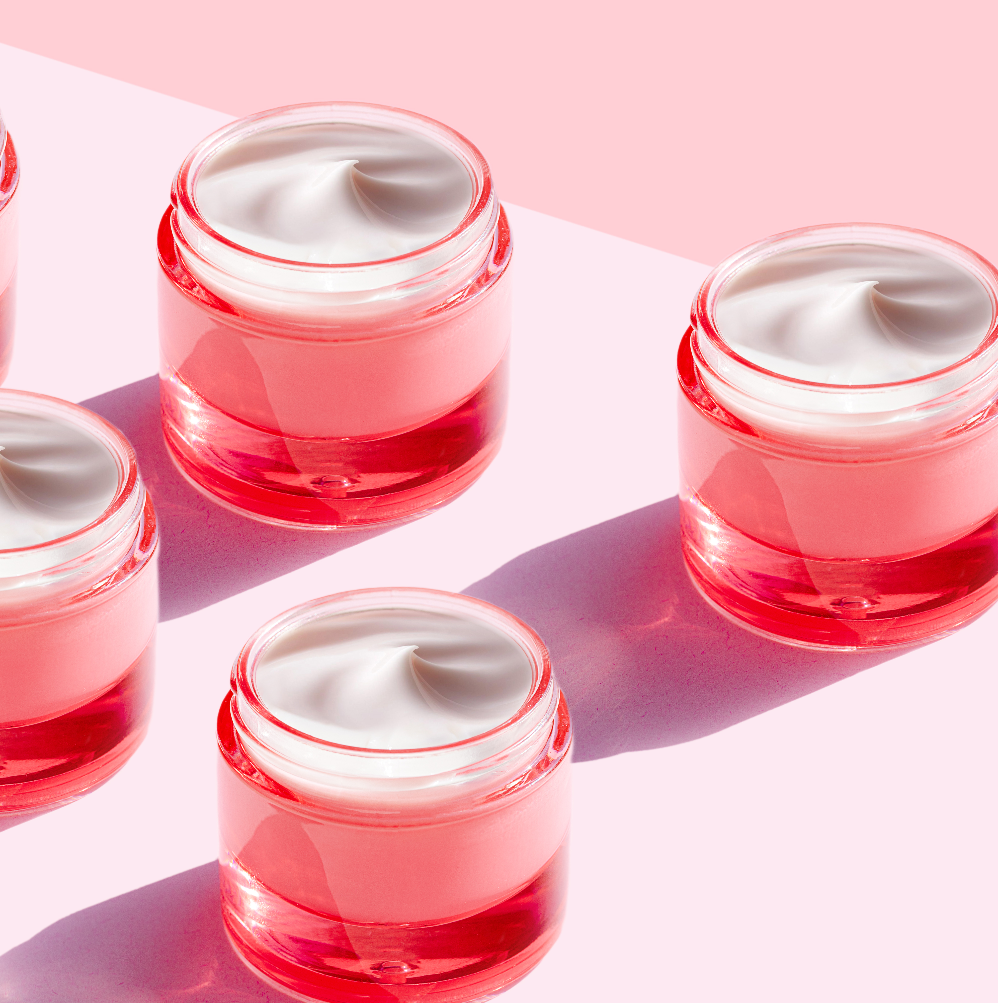
Industrial Applications
Pharmaceutical: eye drops and medications.
Cosmetic: creams and skin care products.
Food: gelling agent and thickener
Paints: Thickener

Slide 5
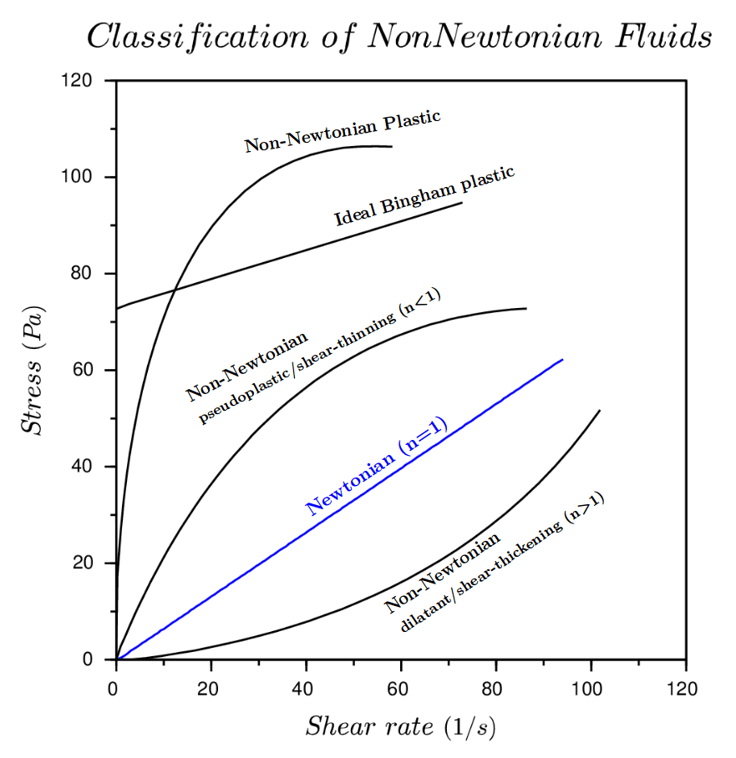
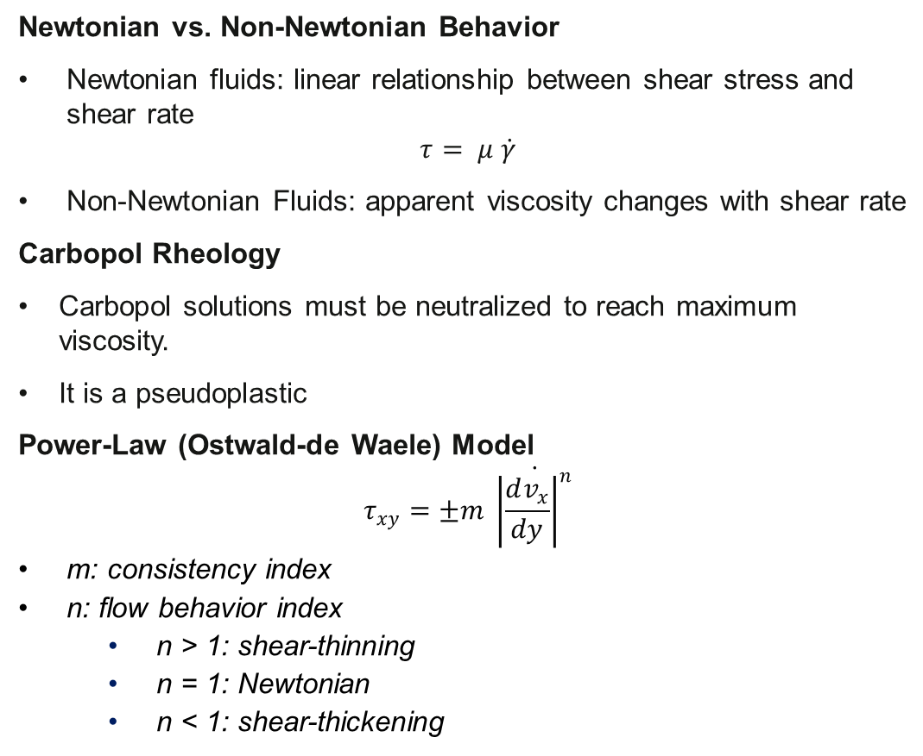
Theory
Newtonian vs. Non-Newtonian Behavior
Newtonian fluids: linear relationship between shear stress and shear rate
$$τ= μ \dot{γ}$$
Non-Newtonian Fluids: apparent viscosity changes with shear rate
Carbopol Rheology
Carbopol solutions must be neutralized to reach maximum viscosity.
It is a pseudoplastic
Power-Law (Ostwald-de Waele) Model
$$τ_{xy}=±m \dot{{\left|\frac{dv_{x}}{dy}\right|}^{n}}$$
m: consistency index
n: flow behavior index
n > 1: shear-thinning
n = 1: Newtonian
n < 1: shear-thickening
(1)

Slide 6
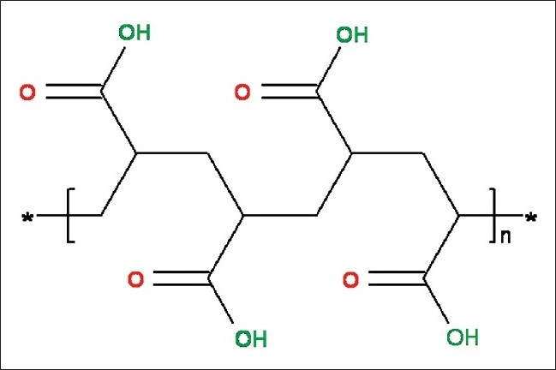
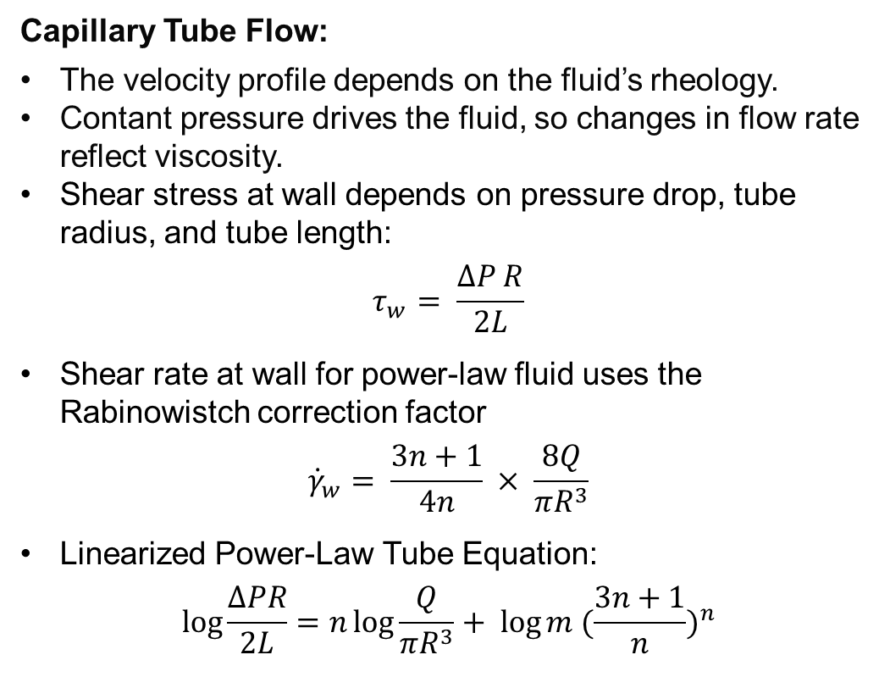
Theory
Capillary Tube Flow:
The velocity profile depends on the fluid’s rheology.
Contant pressure drives the fluid, so changes in flow rate reflect viscosity.
Shear stress at wall depends on pressure drop, tube radius, and tube length:
$$τ_{w}= \frac{∆P R}{2L}$$
Shear rate at wall for power-law fluid uses the Rabinowistch correction factor
$${\dot{γ}}_{w}= \frac{3n+1}{4n} × \frac{8Q}{πR^{3}}$$
Linearized Power-Law Tube Equation:
$$\log{\frac{∆PR}{2L}=n\log{\frac{Q}{πR^{3}}+ \log{m {(\frac{3n+1}{n})}^{n}}}}$$
Figure: Carbopol Structure

Slide 7
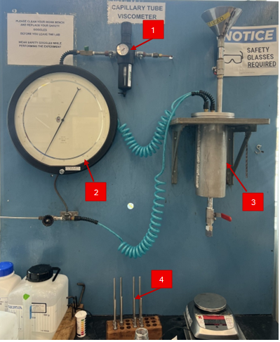

Apparatus
Pressure Regulator: Used to regulate the pressure of the vessel
Pressure Gauge: Reads the pressure controlled by the pressure regulator
Pressurization Vessel: Filled fluid which will be pressurized
Capillary Tubes: Used to measure the viscosity of the fluid

Slide 8
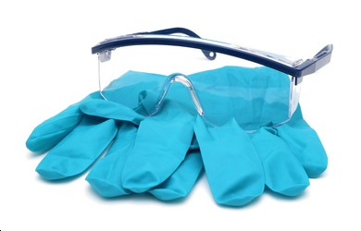
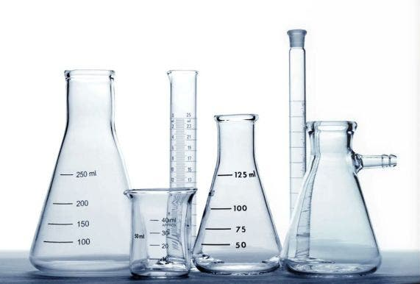
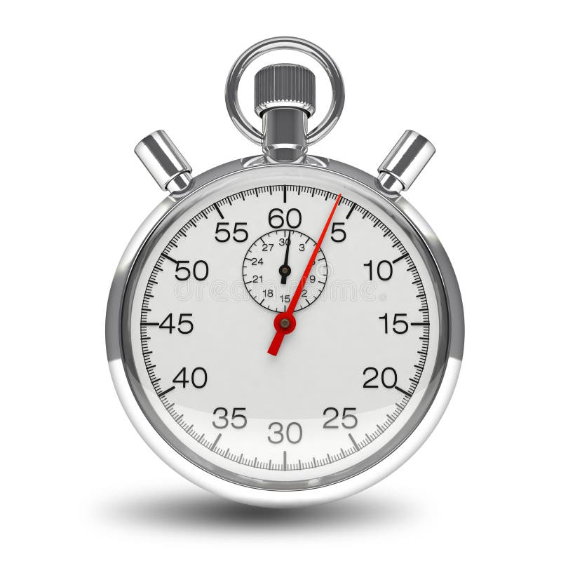
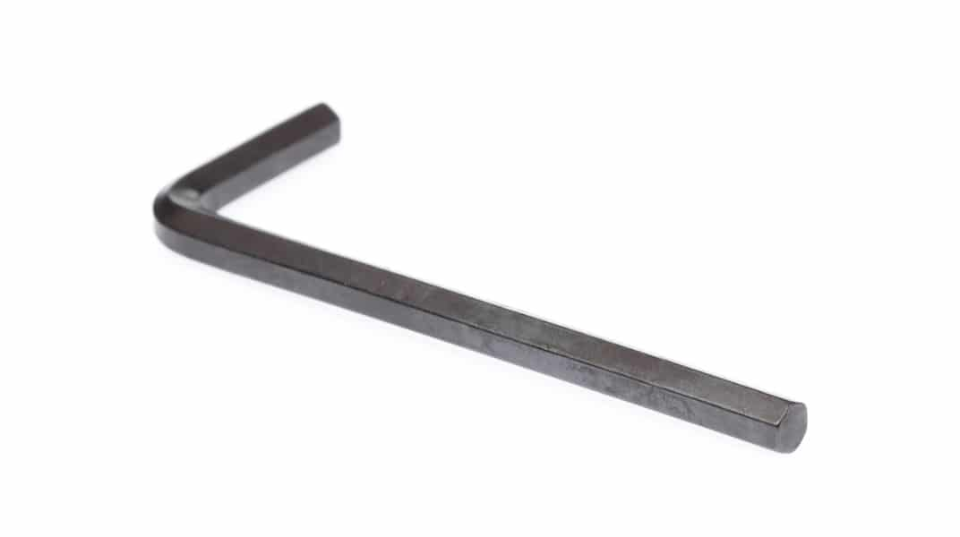
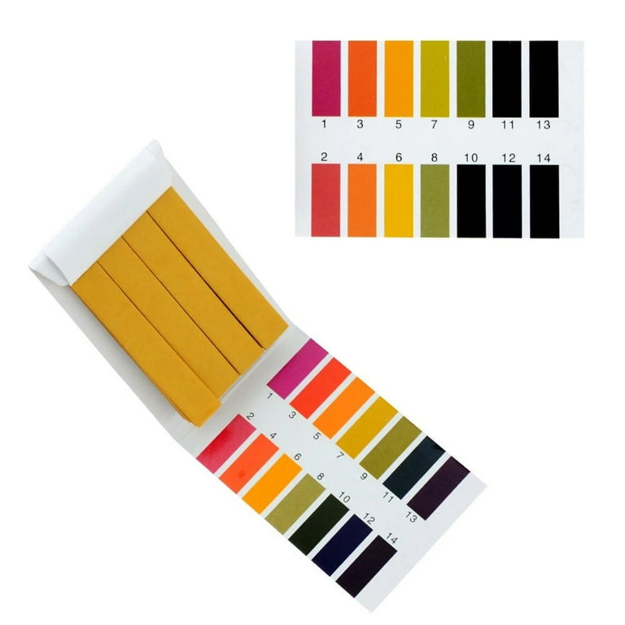
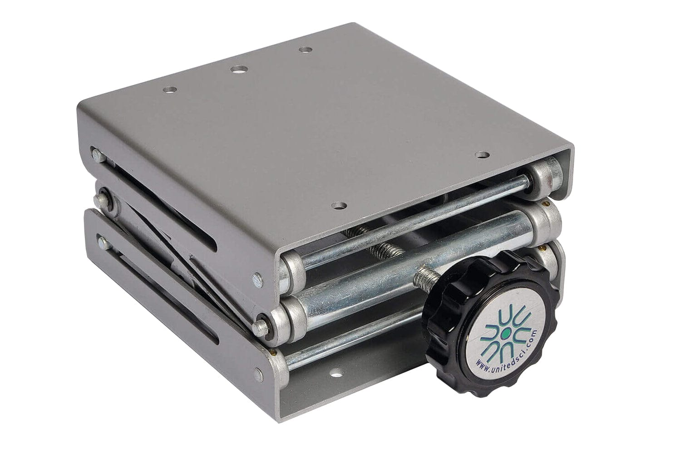
Materials and Supplies
Carbopol 934/940 powder
Grease
Allen Wrench and Screws
Wrench
Scale
pH Strips
Stand Mixer
Plastic Containers
Spatula
Water
Compressed Air Cylinder
1M NaOH Solution
Beakers
Graduated Cylinder
Lab Jack
Measuring Tape
Gloves
Safety Goggles

Slide 9

Prepare approximately 2 liters of a 1.0wt% Carbopol 934 solution in warm water using a power mixer until completely dissolved.
Neutralize the solution by slowly adding 1 N NaOH to adjust the pH to between 5-6, forming a gel-like consistency. Record the final pH value.
To set up the apparatus, connect the capillary tube to the pressurization vessel.
Fill the vessel with the prepared Carbopol solution.
Ensure that the vent valve is opened before filling and closed last during pressurization to maintain safety.
Start the experiment by applying compressed air to the vessel and adjust the regulator to maintain a constant inlet pressure.
Open the valve below the vessel and measure the mass, volume, and time interval of collection
Use at least three pressure values per capillary tube.
Repeat the experiment for tubes with different capillary tubes to observe the effect of geometry on measured parameters
Procedure

Slide 10
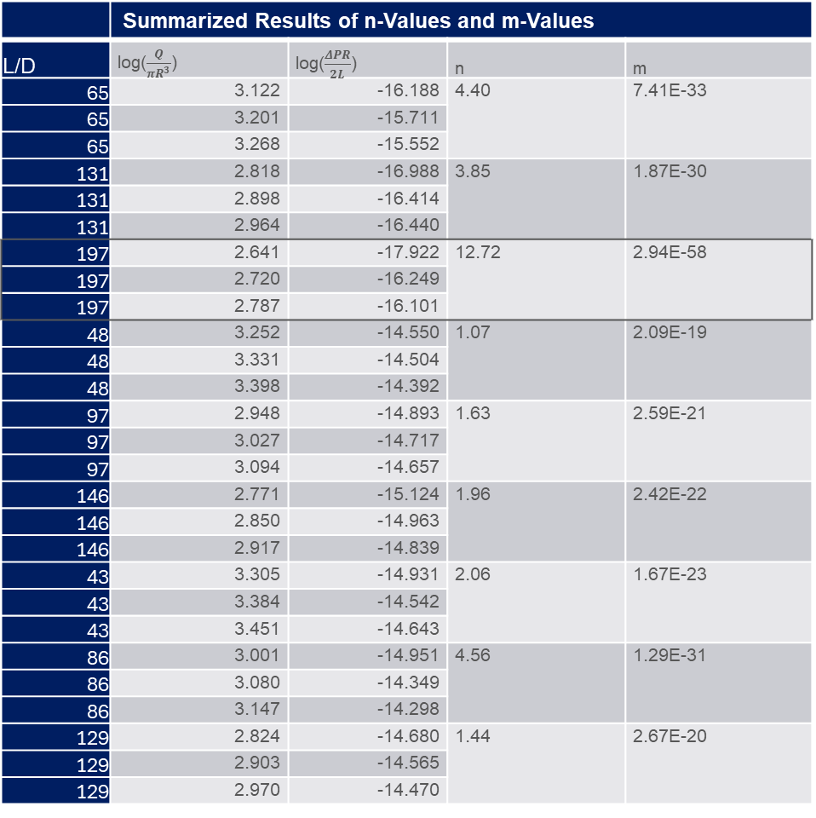
Results and Discussion
 | Summarized Results of n-Values and m-Values
L/D | log​($\frac{Q​}{πR^{3}}$) | log​($\frac{ΔPR​}{2L}$) | n | m
65 | 3.122 | -16.188 | 4.40 | 7.41E-33
65 | 3.201 | -15.711
65 | 3.268 | -15.552
131 | 2.818 | -16.988 | 3.85 | 1.87E-30
131 | 2.898 | -16.414
131 | 2.964 | -16.440
197 | 2.641 | -17.922 | 12.72 | 2.94E-58
197 | 2.720 | -16.249
197 | 2.787 | -16.101
48 | 3.252 | -14.550 | 1.07 | 2.09E-19
48 | 3.331 | -14.504
48 | 3.398 | -14.392
97 | 2.948 | -14.893 | 1.63 | 2.59E-21
97 | 3.027 | -14.717
97 | 3.094 | -14.657
146 | 2.771 | -15.124 | 1.96 | 2.42E-22
146 | 2.850 | -14.963
146 | 2.917 | -14.839
43 | 3.305 | -14.931 | 2.06 | 1.67E-23
43 | 3.384 | -14.542
43 | 3.451 | -14.643
86 | 3.001 | -14.951 | 4.56 | 1.29E-31
86 | 3.080 | -14.349
86 | 3.147 | -14.298
129 | 2.824 | -14.680 | 1.44 | 2.67E-20
129 | 2.903 | -14.565
129 | 2.970 | -14.470
In a capillary rheometer, large L/D or very small diameters distort the n-value
Long, narrow tubes amplify pressure drop measurement errors and are more sensitive to wall slip and the elastic effects of the Carbopol solution
The most reliable n, m values are from tubes with a large radius and a short length
Carbopol solution is determined to be shear-thinning

Slide 11
Results and Discussion
The shear stress increases with increasing velocity gradient, which is characteristic pseudoplastic (shear-thinning) fluid
Carbopol is best described by the power-law model, indicated by strong shear thinning

Slide 12
References
FliteSoftware. (2022). Non-Newtonian Fluids – FluidFlow Blog. Fluidflowinfo.com. https://blog.fluidflowinfo.com/non-newtonian-fluids/
CarboMer. (2024). Carbomer 940 | Understanding Carbomer 940. Retrieved from Carbomer website: https://carbomer.com/carbomer-940-essential-guide-to-uses-benefits-and-precautions/
Rheonics. (2021). Optimizing non-Newtonian mixing applications with viscosity management. Retrieved from rheonics :: viscometer and density meter website: https://rheonics.com/solutions-item/optimizing-non-newtonian-mixing-applications-with-viscosity-management/
Lubrizol Advanced Materials, Inc. (2011). Carbopol® 940 NF polymer: Thickening properties (Pharmaceutical Bulletin No. 6). Lubrizol Corporation.
ChE 381: Unit Operations Laboratory. (2024). Viscosity of a Non-Newtonian Fluid (Rev. Spring 2023v2). University of Illinois Chicago, Department of Chemical Engineering.
Shin, S., & Keum, D.-Y. (2003). Viscosity measurement of non-Newtonian fluid foods with a mass-detecting capillary viscometer. Journal of Food Engineering, 58(1), 5–10.
The Influence of pH Values on the Rheological, Textural and Microstructural Properties of Carbopol Gel. (2020). National Institutes of Health. https://pmc.ncbi.nlm.nih.gov/articles/PMC7663699/

